Slide 1
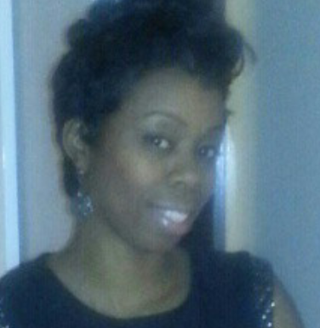

Women Ministry at Work
Becoming A Vessel That God Can Use Isaiah 55:8-9
For Additional Information: Contact Dana Dwirantwi,
215 873-1849 or Dr. Patricia Brown 215 779-8243
New Beginnings
Community Baptist Church
www.nbcbchurch.org
Pastor Kevin B. Williams, Sr.
895 – 897 Bridge Street Philadelphia, PA 19124
Please Join Us For Our
First annual Luncheon On Saturday, March 21, 2015 -- 1:00 P.M. Sharp
Donation: $20.00
Missionary Nicole Scott, Preacher
Come Experience the Word of God and Enjoy a Delicious Lunch

